Slide 1
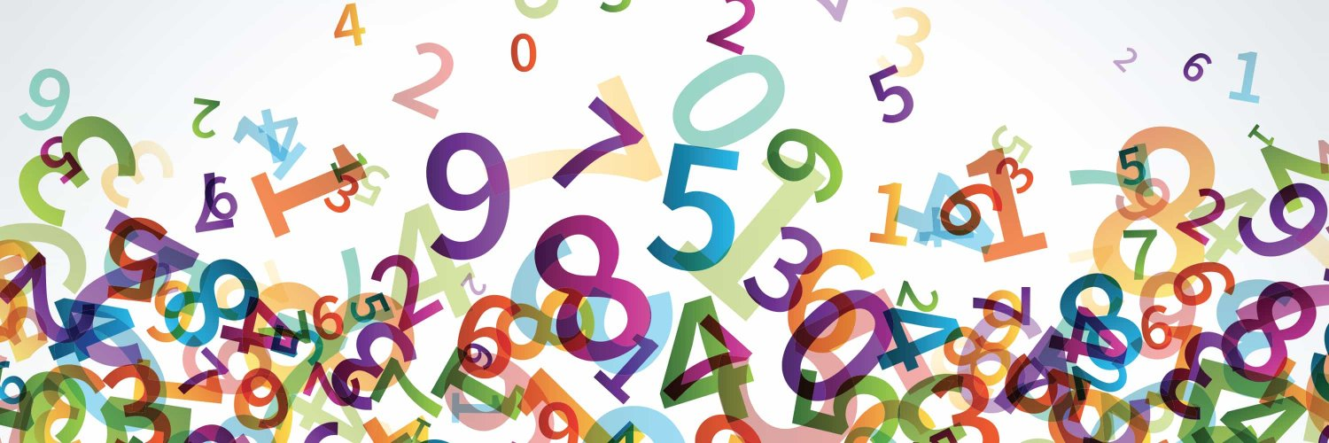
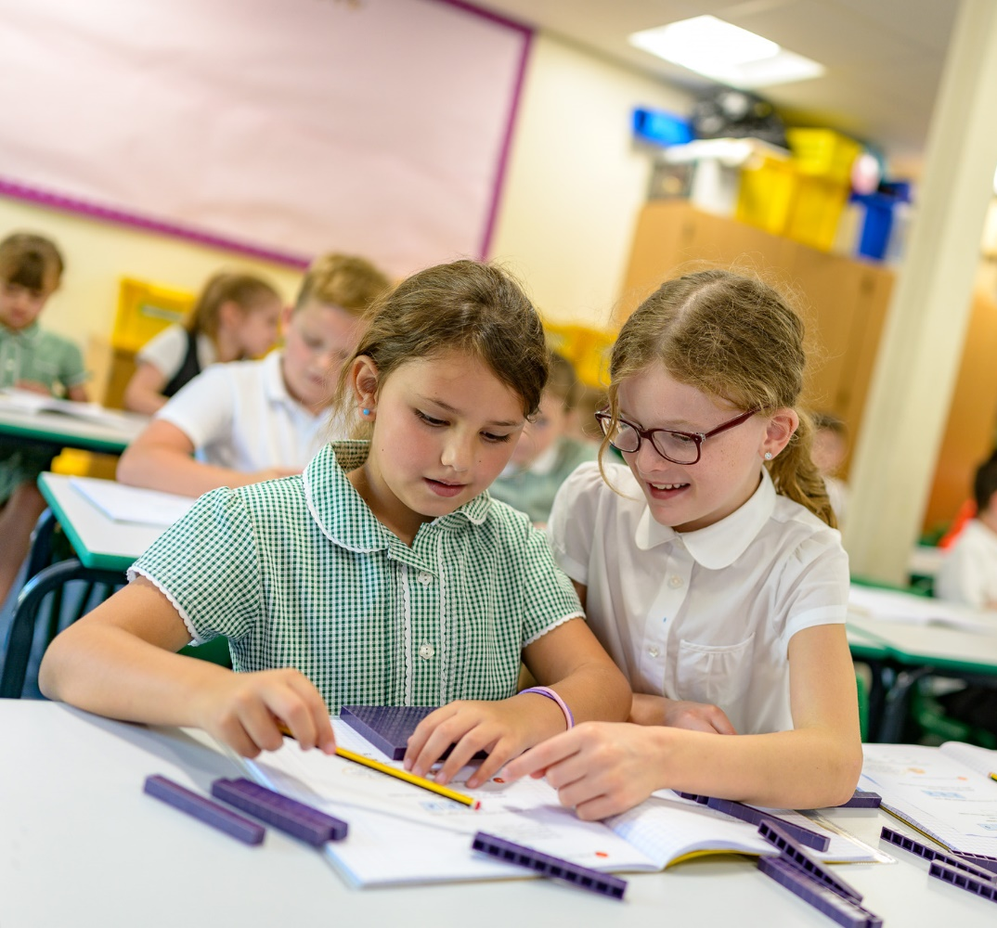

Written Calculation Policy
Sep ‘21
Enabling children to flourish and succeed

Slide 2
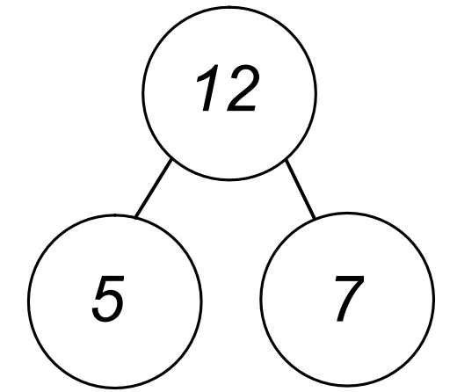
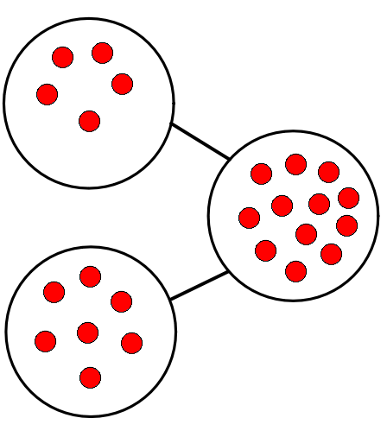
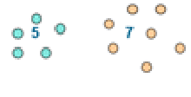
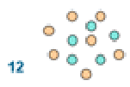
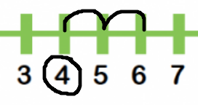
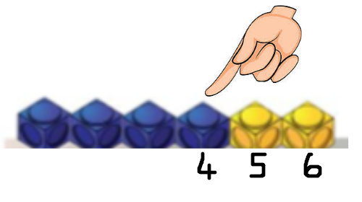
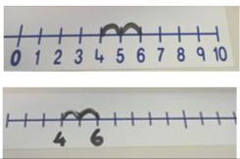
+ Addition
Yr Grp & Vocabulary | Concrete | Pictorial | Abstract
Year 1 Vocabulary: sum, total, plus, add, together, more, parts and wholes, ‘is equal to’, ‘is the same as’ | Combine two parts to make a whole Combining two sets of objects (aggregation) | Represent objects as dots/crosses within a part-whole diagram. | 4 + 3 = 7 7 = 4 + 3 Calculations should be written either side of the equality sign so that the sign is not just interpreted as ‘the answer’. Missing numbers Missing numbers need to be placed in all possible places. 2 + 4 = = 2 + 4 4 + = 6 6 = + 2 Encourage children to use an empty number track.
 | Progress onto adding on to a set (augmentation): Encourage children to count on, rather than count all. | Counting on with a given number line or number track

Slide 3
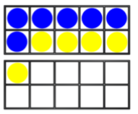
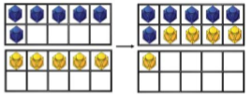
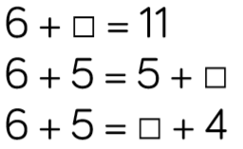
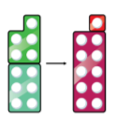
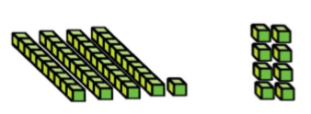
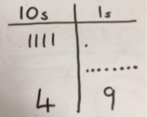
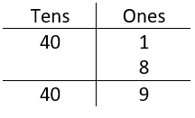
+ Addition
 | Concrete | Pictorial | Abstract
Year 1 continued… | Regrouping to make 10 Using tens frames or Numicon e.g. 6 + 5 | Children to draw onto a ten frame. | Develop an understanding of equality. e.g. 6 + 5 = 10 + 1 Moving onto missing numbers:
Year 2 Vocabulary: sum, total, plus, add, together, more, parts and wholes, ‘is equal to’, ‘is the same as’ | TO + O using base 10 equipment. 41 + 8 | Children to draw representations | Expanded column addition. = 49

Slide 4
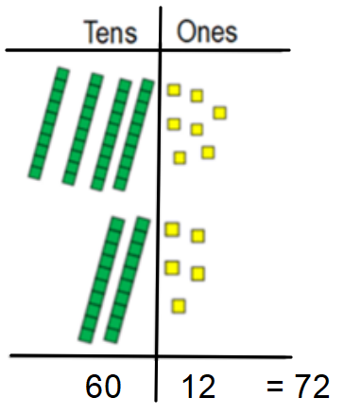
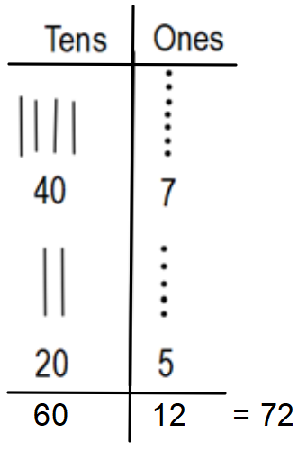
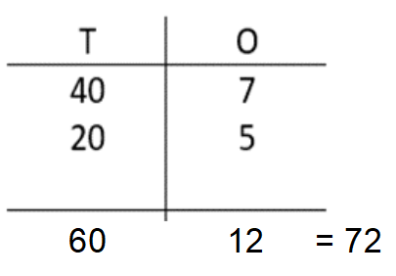
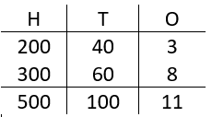
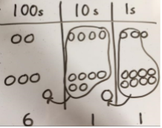
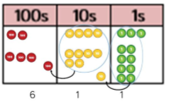
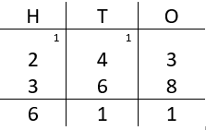
+ Addition
 | Concrete | Pictorial | Abstract
Year 2 continued… | TO + TO using base 10 equipment. 47 + 25 | Represent base 10 using pictures. | Expended column addition
Year 3 Vocabulary: sum, total, plus, add, together, more, parts and wholes, ‘is equal to’, ‘is the same as’ | HTO + HTO using base 10 equipment or place value counters. | Represent base 10 or place value counters with pictures. | Expanded column addition =611 Progressing to:
Year 4, 5 & 6 As above | As above, using larger numbers. | As above, using larger numbers. | As above, using larger numbers.

Slide 5
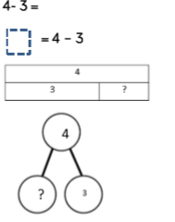
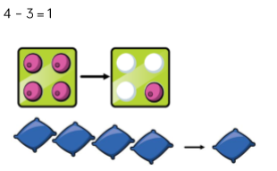
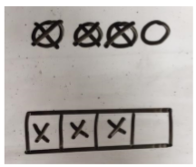
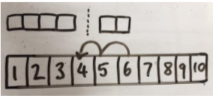
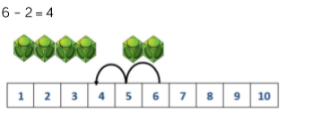
- Subtraction
Yr Grp & Vocabulary | Concrete | Pictorial | Abstract
Year 1 Vocabulary: Subtraction, subtract, take away, distance between, difference between, more than, minus, less than, equals = same as, most, least, pattern, odd, even, digit | Physically taking away and removing physical objects from a whole (tens frames, Numicon, cubes and other items such as beanbags could be used ) | Children to draw the concrete resources they are using and cross out the correct amount. The bar model can be used. | Part-whole diagram and equality
 | Counting back (using number lines or number track as support) children start with 6 and count back 2) | Children to represent what they see pictorially e.g. Use a given number line or number track. | Encourage children to use an empty number line.

Slide 6
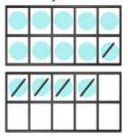
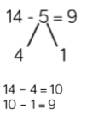
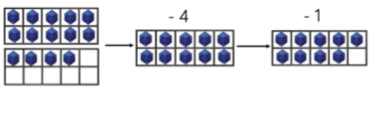
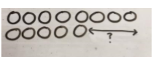
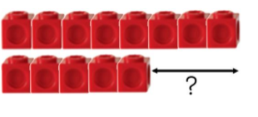
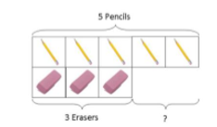
- Subtraction
Year 1 continued.. | Concrete | Pictorial | Abstract
 | Making 10 using ten frames. 14- 5 | Children to present the tens frame pictorially and discuss what they did to make 10. | Children to show how they can make 10 by partitioning the subtrahend.
 | Finding the difference (using cubes, Numicon or Cuisenaire rods, other objects can also be used). Calculate the difference between 8 and 5. | Children to draw the cubes/other concrete objects which they have used to illustrate what they need to calculate. | Find the difference between 8 and 5. 8- 5, the difference is ____ Children to explore why 9-6 = 8- 5= 7 – 4 have the same difference.

Slide 7
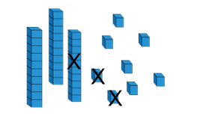
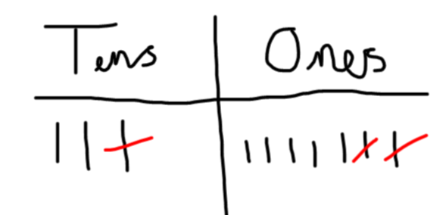

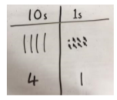
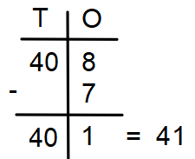
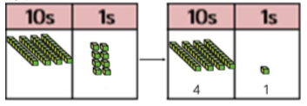
- Subtraction
Yr Grp & Vocabulary | Concrete | Pictorial | Abstract
Year 2 Vocabulary: Subtraction, subtract, take away, difference, difference between, minus Tens, ones, partition Near multiple of 10, tens boundary Less than, one less, two less… ten less… one hundred less | Use partitioning of tens and ones to subtract a 2 digit number from another 2 digit number with no regrouping involved. 37 – 12 = 37 – 10 = 27 27 – 2 = 25 | Children to present the 2 digit number using a pictorial image. 37- 12 ( subtract 10, subtract 2) = 25 | Children to use a number line to show partitioning of the 2 digit number 10 and 2, then to subtract this from 37 separately. 37 – 12 =
 | Column method using base 10. 48-7 | Children to represent the base 10 pictorially were no renaming is required | Children to use the expanded form of column subtraction.

Slide 8
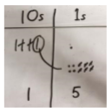
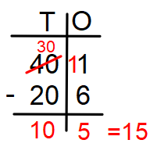

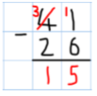
- Subtraction
Year 2 continued… Vocabulary: Renaming | Concrete | Pictorial | Abstract
 | Column method using base 10 and having to rename. 41-26 | Represent the base 10 pictorially, remembering to show the renaming. | Expanded column method Progressing to the formal column method when ready. Children must understand that when they have renamed the 10 they still have 41 because 41 = 30 + 11.

Slide 9
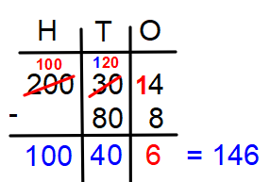
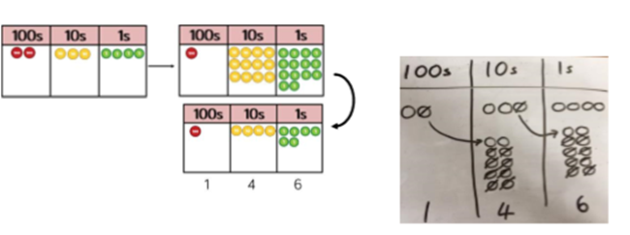
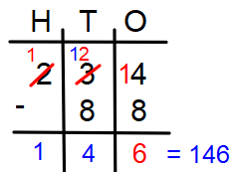
- Subtraction
 | Concrete | Pictorial | Abstract
Year 3 Vocabulary: Hundreds, tens, ones, estimate, partition, recombine, difference, decrease, near multiple of 10 and 100, inverse, rounding, column subtraction, rename See also Y1 and Y2 | Column method using place value counters. 234-88 | Represent the place value counters pictorially ; remembering to show what has been renamed. | Expanded column method Formal column method. Children must understand what has happened when they have crossed out digits.
Years 4, 5 and 6 | Continue to follow concrete, pictorial and abstract model from Year 3 to meet the needs of each specific year group.

Slide 10


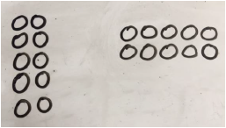
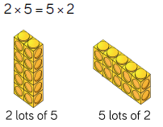
x Multiplication
Yr Grp & Vocabulary | Concrete | Pictorial | Abstract
Year 1 Vocabulary: multiplication, lots of, groups of, double, arrays, repeated addition | Repeated grouping/repeated addition Washing line, and other practical resources for counting. Concrete objects. Numicon; bundles of straws, bead strings etc | Children to represent the practical resources in a picture and using a number line | 2 x 5 = 10 2 + 2 + 2 + 2 + 2 = 10 2 multiplied by 5 5 pairs 5 jumps of 2 Abstract number line showing 5 jumps of 2
 | Use arrays to understand multiplication can be done in any order (commutative). Counters and other objects can be used | Children to represent the arrays pictorially | 2 x 5 = 10 5 x 2 = 10 10 = 2 x 5 10 = 5 x 2 2 + 2 + 2 + 2 + 2 = 10 5 + 5 = 10
2 x 5 = 10
5 x 2 = 10
5 x 2 = 10
2 x 5 = 10

Slide 11

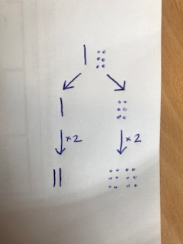
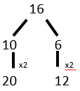
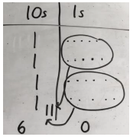


x Multiplication
Yr Grp & Vocabulary | Concrete | Pictorial | Abstract
Continue to build on the understanding of Year 1 strategies and vocabulary Year 2 Vocabulary: facts, odd, even, commutative, inverse | Doubling - begin to develop an understanding doubling of 2 digit numbers up to 50 16 x 2 | Children may start to represent the materials pictorially | Begin to use jottings towards recording the written method
Continue to build on the understanding of Year 2 strategies and vocabulary Year 3 Vocabulary: scaling | Partition to multiply using Numicon, base 10 or Cuisenaire rods |  | Children to be encouraged to show the steps they have taken
x2
x2

Slide 12









x Multiplication
Yr Grp & Vocabulary | Concrete | Pictorial | Abstract
Year 3 continued… | Grid method using place value counters or base 10 18 x 3
 | Being to use expanded column method (long multiplication) using place value counters or base 10 23x2
 | Begin to use formal column method (short multiplication) with place value counters or base 10 3x23 |  | Record what is being done to show understanding

Slide 13





x Multiplication
Yr Grp & Vocabulary | Concrete | Pictorial |  | Abstract
Continue to build on the understanding of Year 3 strategies and vocabulary Year 4 Vocabulary: associative law, distributive law | Formal column method (short multiplication) with place value counters or base 10 6x23 |  |  | Formal written method
Year 5 and Year 6 – continue to build on and deepen the understanding of strategies and vocabulary in previous years. When children start to multiply 3 digit x 3 digit and 4 digit x 2 digit (including decimals) they should be confident with the abstract (formal written methods). Vocabulary: multiple, factor, prime number, prime factor, composite number, square number, cubed number, equivalence, powers

Slide 14






÷ Division
Yr Grp & Vocabulary | Concrete | Pictorial | Abstract
Year 1 Vocabulary: share, share equally, one each, two each…, group, groups of, lots of, array | Sharing using a range of objects 6 ÷ 2 | Represent the sharing pictorially. | 6 ÷ 2 = 3 Children should also be encouraged to use their 2 times table facts.
 | Group AND share small quantities- understanding the difference between the two concepts. Sharing Develops importance of one-to-one correspondence. | Children to draw grouping and sharing small quantities. ÷ 5 = 3 Sharing Grouping

Slide 15




÷ Division
Yr Grp & Vocabulary | Concrete | Pictorial | Abstract
Year 1/2 | Count how many groups go in to the dividend. 6 ÷ 2 | Children to represent counting how many groups go in to the dividend | Abstract number line to represent that equal groups that have been counted.
Year 2 Vocabulary: group in pairs, 3s … 10s etc equal groups of divide, ÷, divided by, divided into, remainder | Use of cubes to illustrate the whole- and parts of division. | Use the bar model to show grouping.
5 | 5 | 5
15

Slide 16





÷ Division
Yr Grp & Vocabulary | Concrete | Pictorial | Abstract
Year 3 Vocabulary: Inverse group, groups of, lots of, array, group in pairs, 3s … 10s etc equal groups of divide, ÷, divided by, divided into, remainder | TO ÷ O with remainders using lollipop sticks. Cuisenaire rods, above a ruler can also be used . 13 ÷ 4 = Use of lollipops sticks to form wholes- squares are made because we are dividing by 4. There are 3 whole squares, with 1 left over. | Children to represent the lollipop sticks pictorially. There are 3 whole squares, with 1 left over. | 13 ÷ 4 = 3 remainder 1 Children should be encouraged to use their times table facts; they could also represent repeated addition on a number line. ‘3 groups of 4, with 1 left over’
 | Using grouping to become more efficient at dividing larger numbers. | Use grouping on a bar model. | Becoming more efficient using a number line Children need to be able to partition the dividend in different ways.

Slide 17




÷ Division
Yr Grp & Vocabulary | Concrete | Pictorial | Abstract
Year 4 Vocabulary: divide, divided by, divisible by, divided into share between, groups of factor, factor pair, multiple times as (big, long, wide …etc) equals, remainder, quotient, divisor inverse | Sharing using place value counters. 42 ÷ 3 = 14 | Children to represent the place value counters pictorially. | Children to be able to make sense of the place value counters and write calculations to show the process. 42 ÷ 3 40 = 30 + 12 ÷ 3 = 10 12 ÷ 3 = 4 10 + 4 = 14
Year 5 Vocabulary: divide, divided by, divisible by, divided into share between, groups of factor, factor pair, multiple times as (big, long, wide …etc) equals, remainder, quotient, divisor inverse | Short division using place value counters to group. 615 ÷ 5 Make 615 with place value counters. How many groups of 5 hundreds can you make with 6 hundred counters? 3. Exchange 1 hundred for 10 tens. 4. How many groups of 5 tens can you make with 11 | Represent the place value counters pictorially. | Short division

Slide 18






÷ Division
Yr Grp & Vocabulary | Concrete | Pictorial | Abstract
Year 6 Vocabulary: divide, divided by, divisible by, divided into share between, groups of factor, factor pair, multiple times as (big, long, wide …etc) equals, remainder, quotient, divisor inverse | We can’t group 2 thousands into groups of 12 so exchange them. We can group 24 hundreds into groups of 12 which leaves 1 hundred. After exchanging the hundred, we have 14 tens. We can group 12 tens into a group of 12, which leaves 2 tens. After exchanging the 2 tens, we have 24 ones. We can group 24 ones into 2 groups of 12, which leaves no remainder. |  | Children should write a list of key facts before calculating. 24 48 60 72 84 96

Slide 19


÷÷ Division
Yr Grp & Vocabulary | Abstract
Year 6 continued… | Chunking for long division: Children write a list of key facts before calculating.

