Slide 1
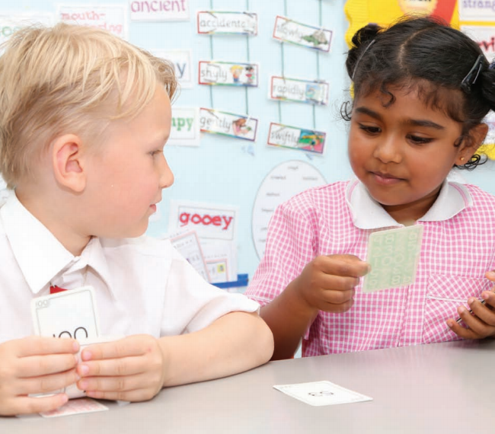
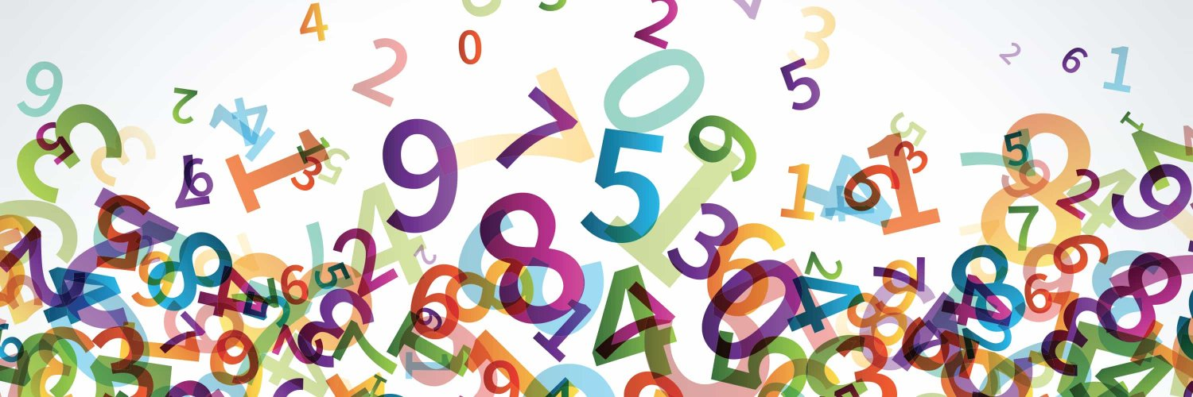

Progression in
Reasoning:
A Whole School Policy
Enabling children to flourish and succeed

Slide 2
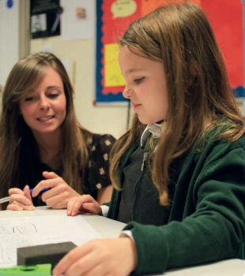
What is reasoning?
The national curriculum for mathematics aims to ensure that all pupils:
reason mathematically by following a line of enquiry, conjecturing relationships and generalisations, and developing an argument, justification or proof using mathematical language
This is one of 3 aims of the national curriculum (alongside fluency and problem solving).
Enabling children to flourish and succeed

Slide 3

Why is reasoning important?
Research by Nunes (2009) identified the ability to reason mathematically as the most important predictor of a pupil’s success in mathematics. It is therefore crucial that opportunities to develop mathematical reasoning skills are integrated fully into the curriculum. Such skills support deep and sustainable learning and enable pupils to make connections in mathematics.
Enabling children to flourish and succeed

Slide 4
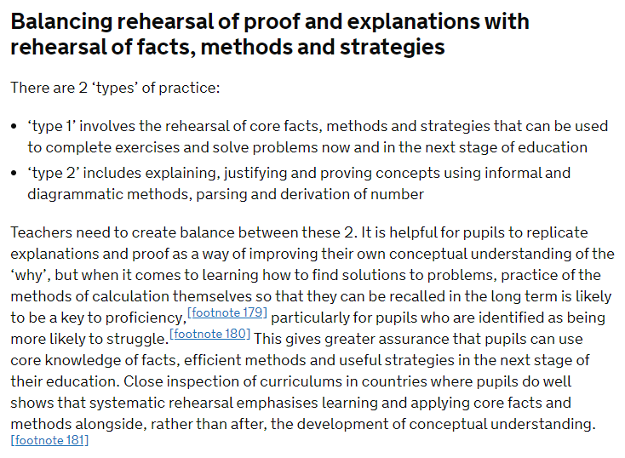

Effective maths teaching requires a balance between rehearsal and reasoning
(Ofsted, May 2021)
Read the full review here: Research review series: mathematics - GOV.UK (www.gov.uk)
Enabling children to flourish and succeed

Slide 5
Progression in Reasoning
True or False?
When I count in 4s I will say 89
Describing
What did you do?
Explaining
Why did you do what you did?
Convincing
Can you begin to form an argument?
Justifying
Can you form a correct, logical argument?
Proving
Will this always happen? How do you know?
Can you generalise using mathematical structures?
“Multiples of 4 divide by 4 to give a whole number.
89 ÷ 4 has a remainder so it’s false.”
“False because I’ll say 88 and 92 but not 89.”
“False because I divided 89 by 4 to see if it is a multiple of 4 and it’s not.”
“All multiples of 4 are even so I won’t say any odd numbers when counting in 4s.”
“89 is a prime number so I will never say 89 when counting in multiples.”
Enabling children to flourish and succeed

Slide 6

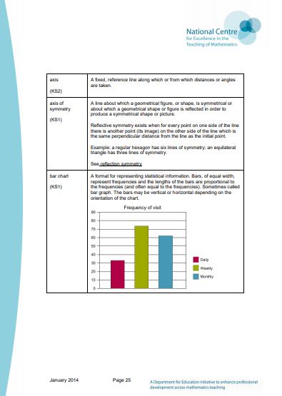
The importance of vocabulary
In order to reason effectively, children need to be confident in the use of precise mathematical vocabulary. This should be explicitly taught during maths lessons. An effective way to do this is to ask children to answer questions in full sentences.
The use of precise mathematical vocabulary allows clarity in explanation and strengthens understanding (for both the speaker and listener).
The NCETM have published a glossary to support teachers with their subject knowledge in the use of vocabulary in maths.
Mathematics Glossary for Teachers (ncetm.org.uk)
Enabling children to flourish and succeed

Slide 7
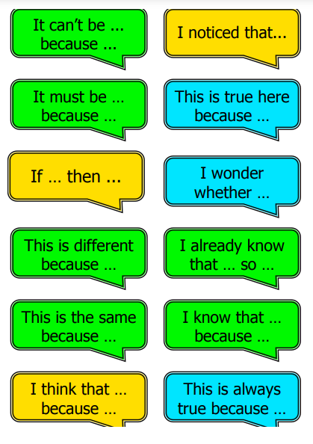
Using Sentence Stems
Sentence stems are helpful to scaffold children’s explanations. Stem sentences should also be used to rehearse important facts e.g. “Prime numbers have only two factors; one and itself”.
Strategies and pedagogical choices are important when developing stem sentences. An ‘I say, you say, we say’ approach can be effective: firstly, model the stem sentence so that pupils can hear mathematical vocabulary used accurately and correctly, then invite a selection of children to say the stem sentence, allowing them to rehearse reasoning. Finally, invite the whole class to say the stem sentence together. In doing so, you’re explicitly teaching children to reason, deepening their understanding of mathematical structures and avoiding vague responses.
Enabling children to flourish and succeed

Slide 8
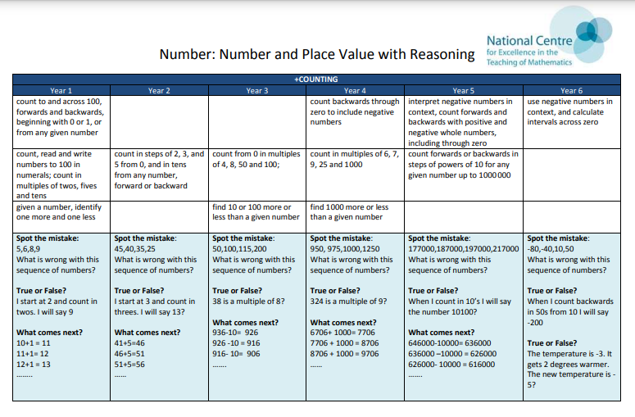
NCETM: Progression in Reasoning Activities
The following resource from the NCETM is designed to support teachers to plan rich reasoning activities throughout the maths curriculum.
National Curriculum objectives are displayed across the top (with a white background) and are matched to a variety of reasoning activities (shaded sections) underneath. The overall aim is to support progression in reasoning skills. The activities also offer the opportunity for children to demonstrate depth of understanding, and teachers might choose to use them for assessment purposes as well as regular classroom activities.
National curriculum objectives
Matched reasoning activities
Enabling children to flourish and succeed

